Slide 1

Modular Consistency Checking Between Heterogeneous Models Without Direct Data Exchange Between Collaborators
Sebastian Bergemann¹, Nina Benkendorf¹
¹ fortiss, Research Institute of the Free State of Bavaria, Munich, Germany
CoPaMo @ MODELS 24
22.09.2024

Slide 2

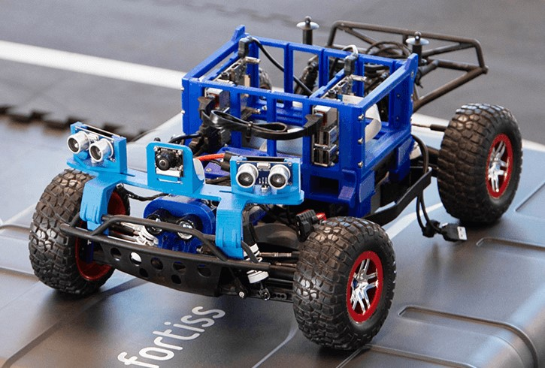
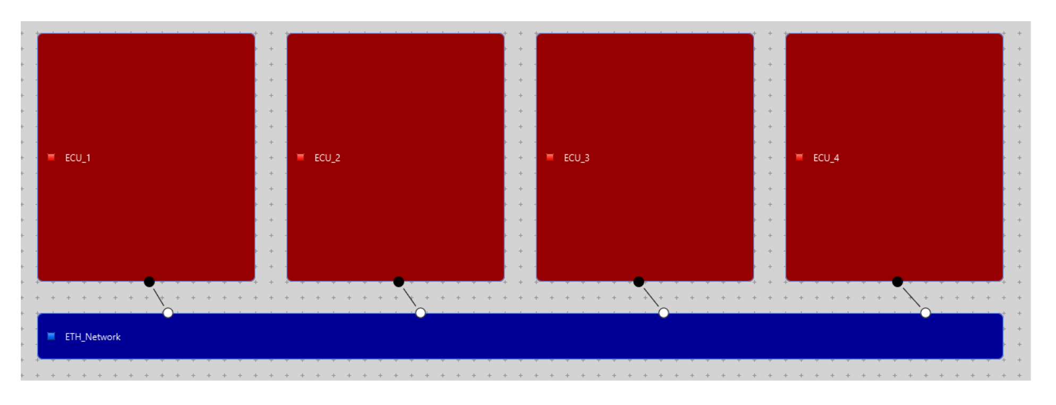
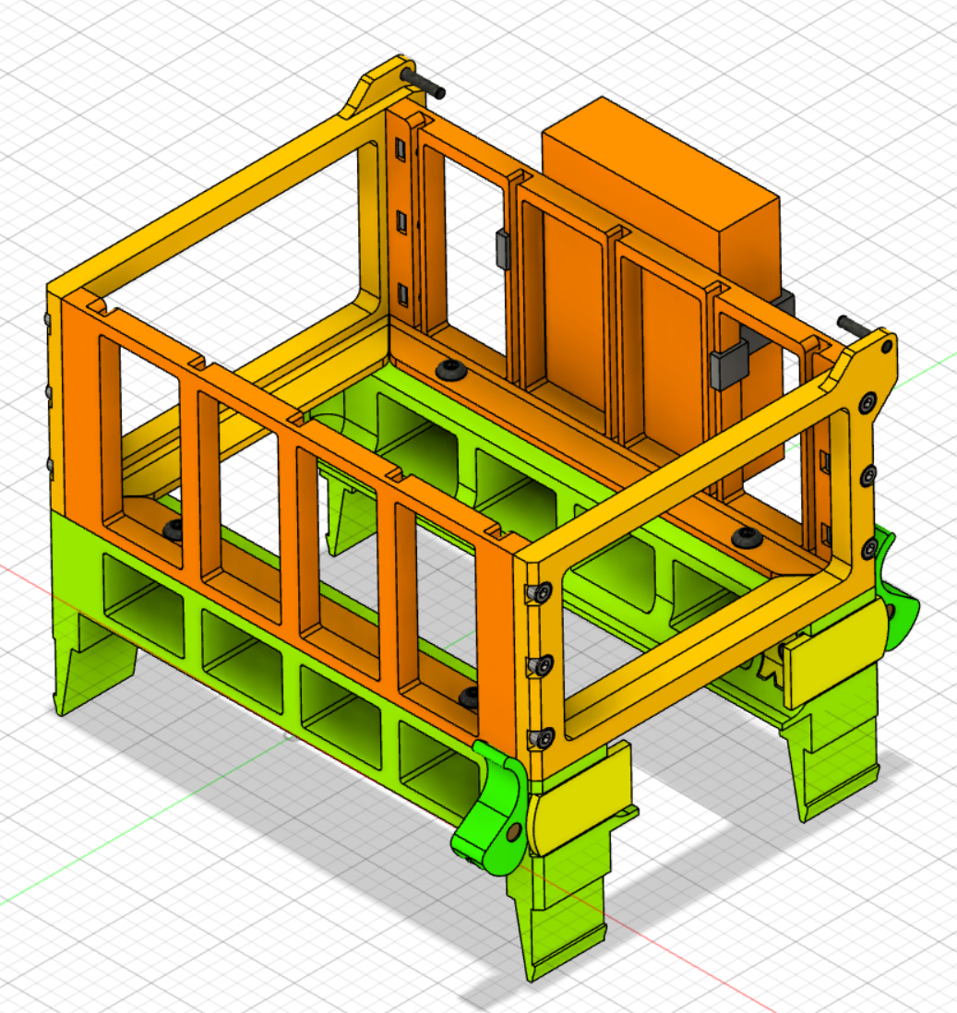
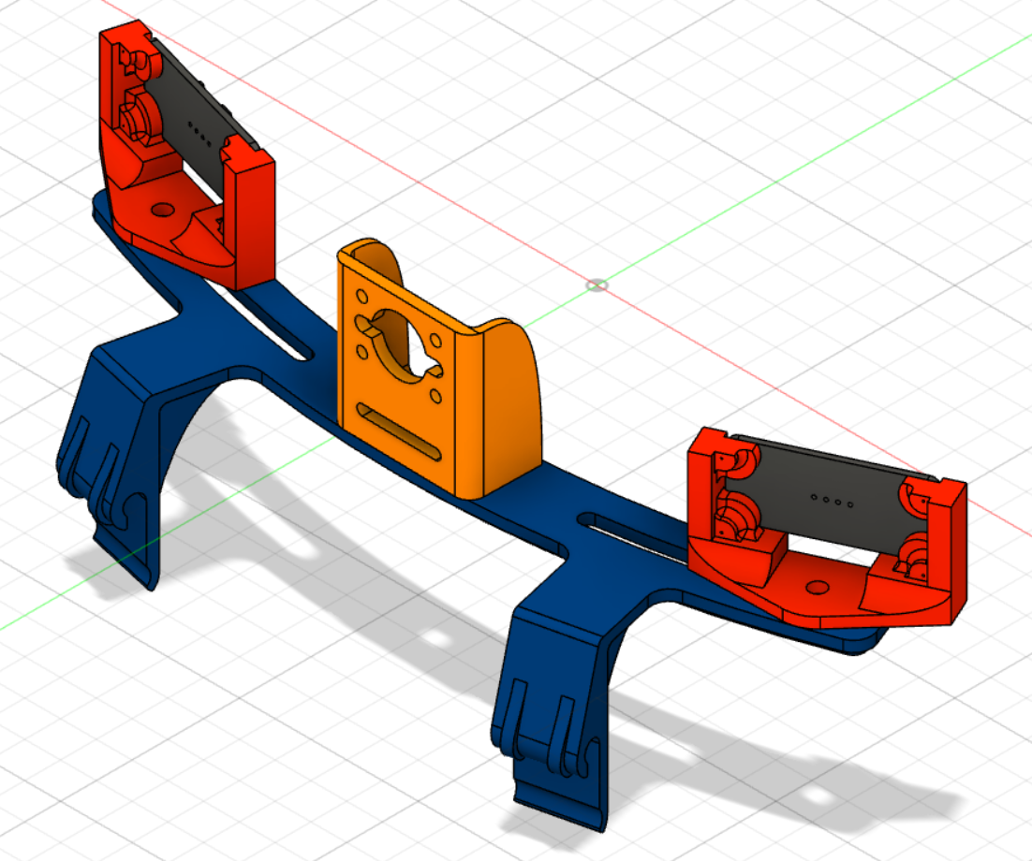






Motivation
Cyber-physical system with MBSE
… collaboratively developed by different parties
On a real example
Hardware architecture + deployment
Hardware geometry + material information
Different models
Models can have overlaps:
# of needed execution units
# of deployed execution units
Possible space in the mount for execution units
Density
Material
Annotated weight
Real weight
Confidential = not shared/leaked with/to unauthorized parties
Volume
Geometry
(Hidden) inconsistencies can cause problems
Beneficial: (early) inconsistency detection

Slide 3
Problem and Gap
Summed up
Consistency Checking (maximum data exchange)
Confidentiality Preservation (none/minimum data exchange)
Ungoverned direct data exchange between parties for consistency checking is too risky for parties that do not fully trust each other
Problem
Literature Gap
Lack of handling the confidentiality issue within active multi-model inconsistency detection approaches

Slide 4




Contribution
An approach on how to check consistency
between models from different parties
without directly exchanging model data between them
Contribution
Presentation focus:
Concept
Middleman - Adapters
Tool
“Central Confidential Consistency Checker” (C⁴)

Slide 5
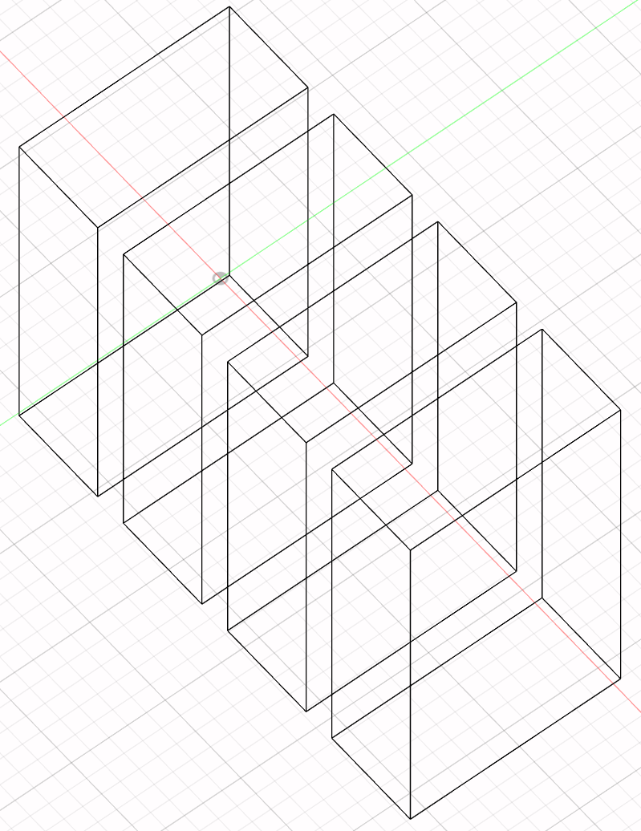











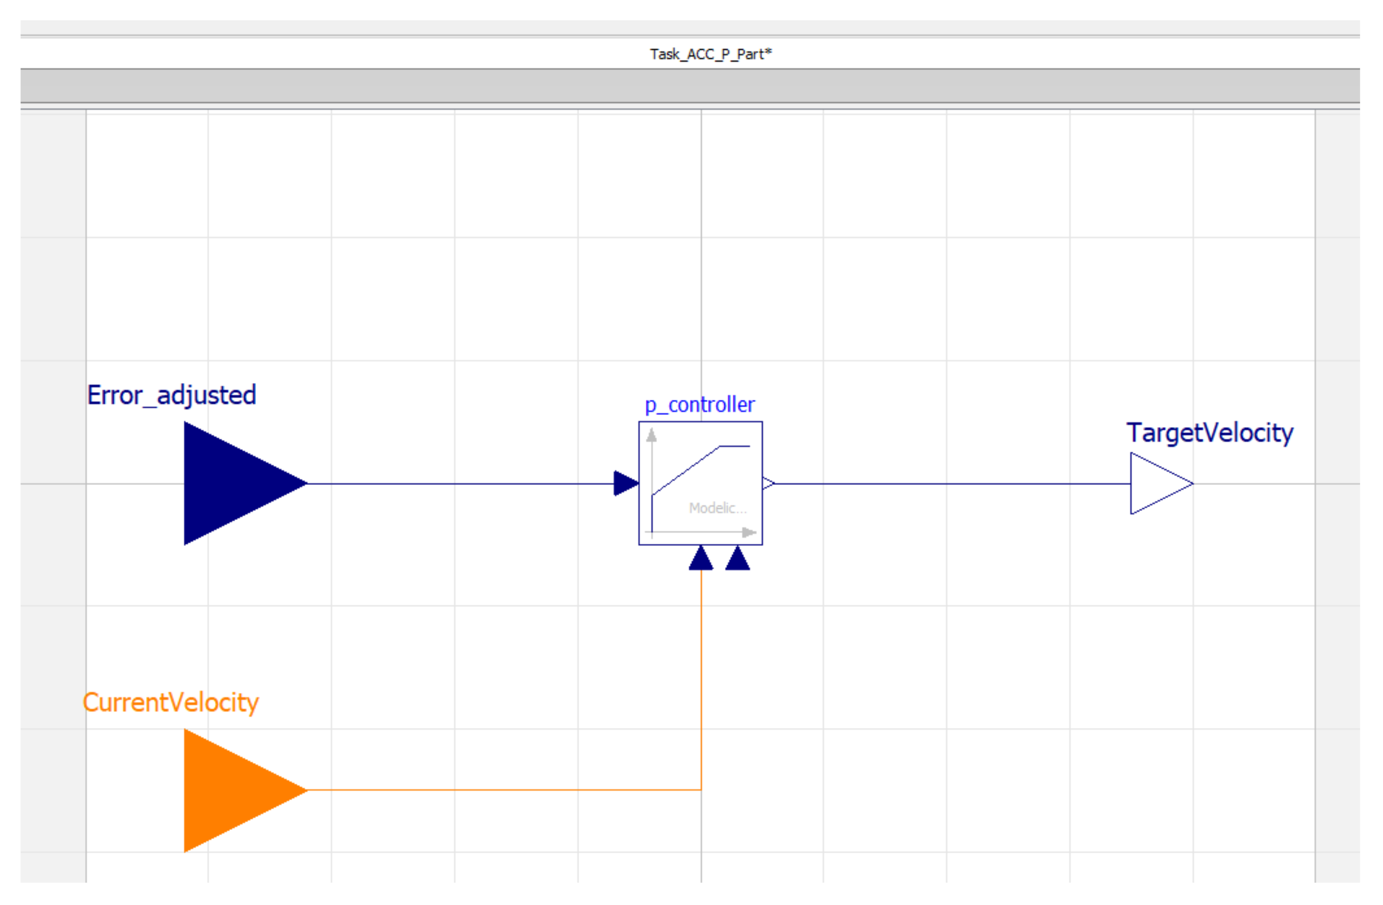
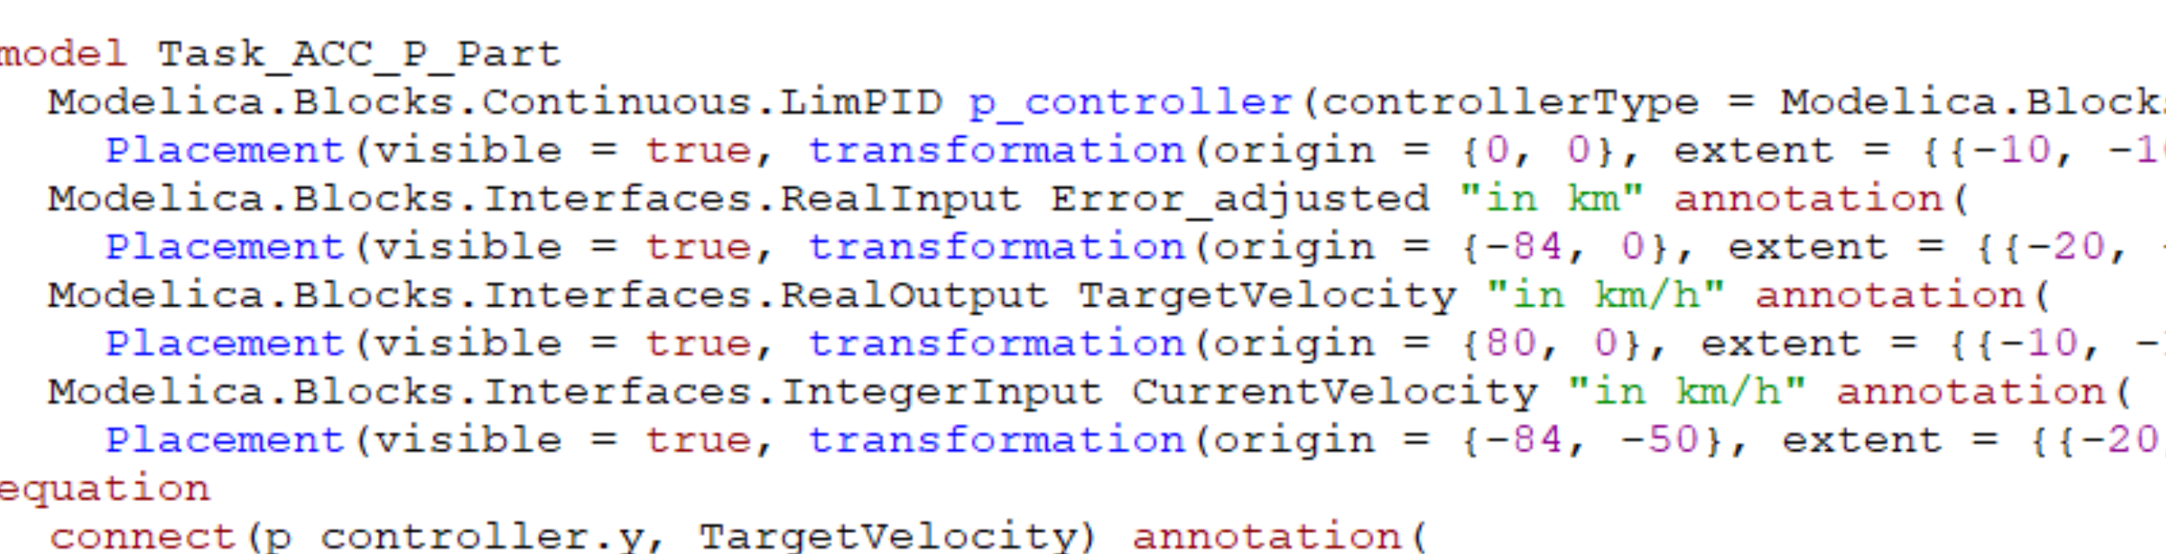

Concept
Overview
Adapter
Middleman
Adapter
Adapter
Adapter

Slide 6




Concept
More details
Represents consistency relations as logical rules
Rules give results for relation satisfaction (→ evaluator)
Adapter
Contains viewtypes defined and agreed on by the parties → flexible common semantic representation between the models
Adapter
Consistency Rule Set
Viewtype Collection
C⁴ requests minimal data via reduced viewtypes
Adapters provide approved data via views
Link Model
Rule Evaluator
Adapter
Adapter
Contains related/linked elements across models
Evaluates rule conditions based on given context data

Slide 7
Prototype
Central Confidential Consistency Checker (C⁴)
Rule conditions written in OCL (depends on used evaluator)
Can be extended with clearance attributes for access control
Adapter
C⁴
Viewtypes based on Eclipse Modeling Framework (EMF)
Adapter
Consistency Rule Set
Viewtype Collection
Client-server communication via HTTPS REST API
Link manager interface
Different possibilities to connect and add links (manual, via tracing system, via semantic equivalence finder, …)
Link Model
Rule Evaluator
Adapter
Adapter
Evaluator interface
Currently implemented with the evaluator from Object Constraint Language (OCL) Eclipse plugin

Slide 8
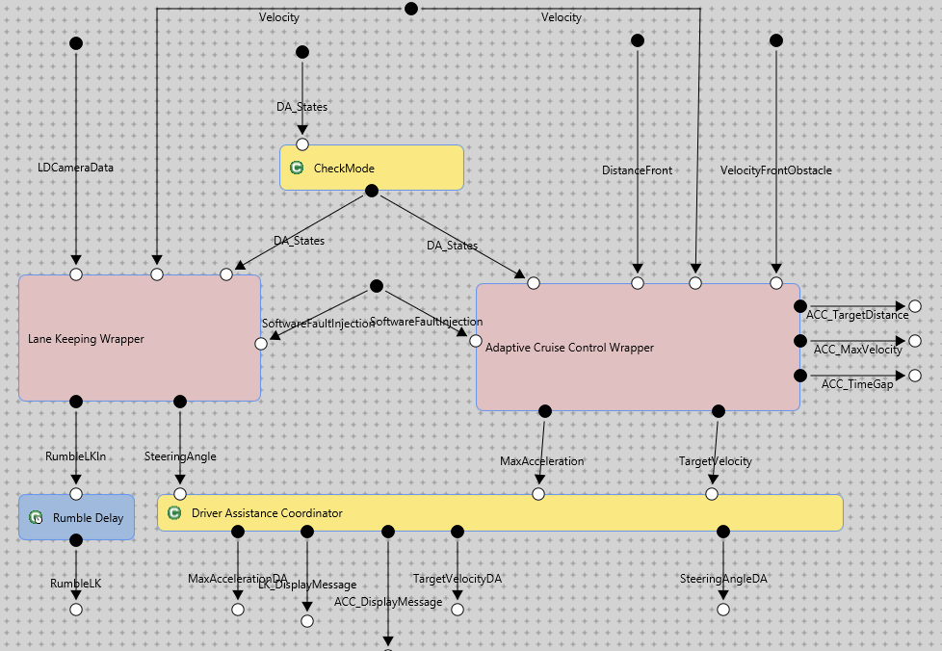
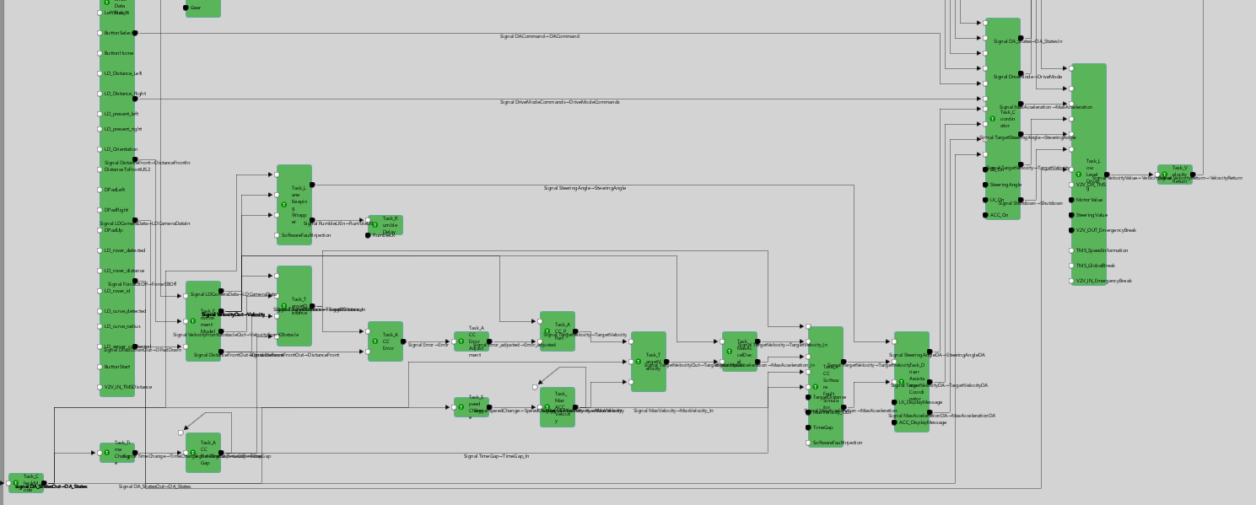
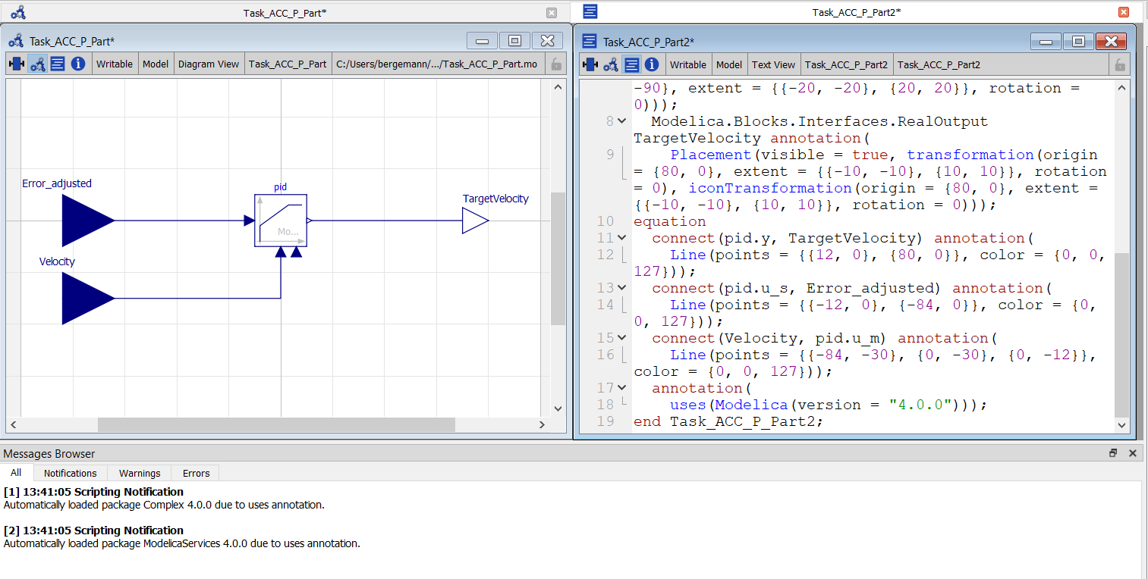
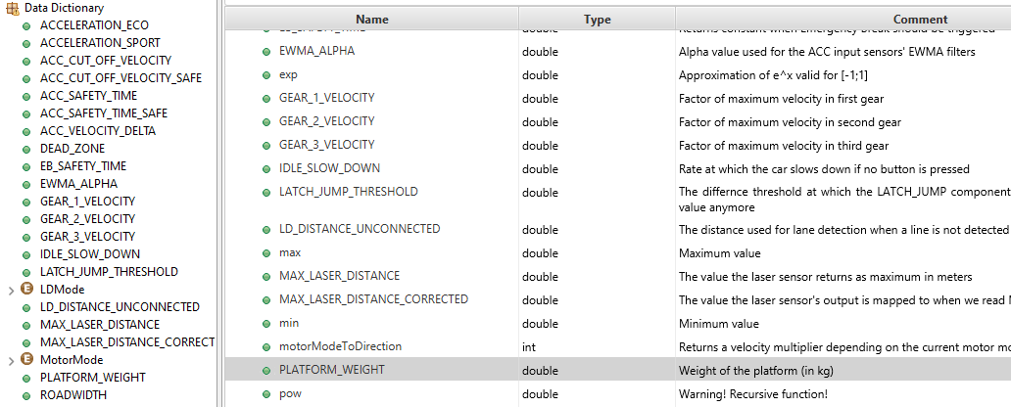
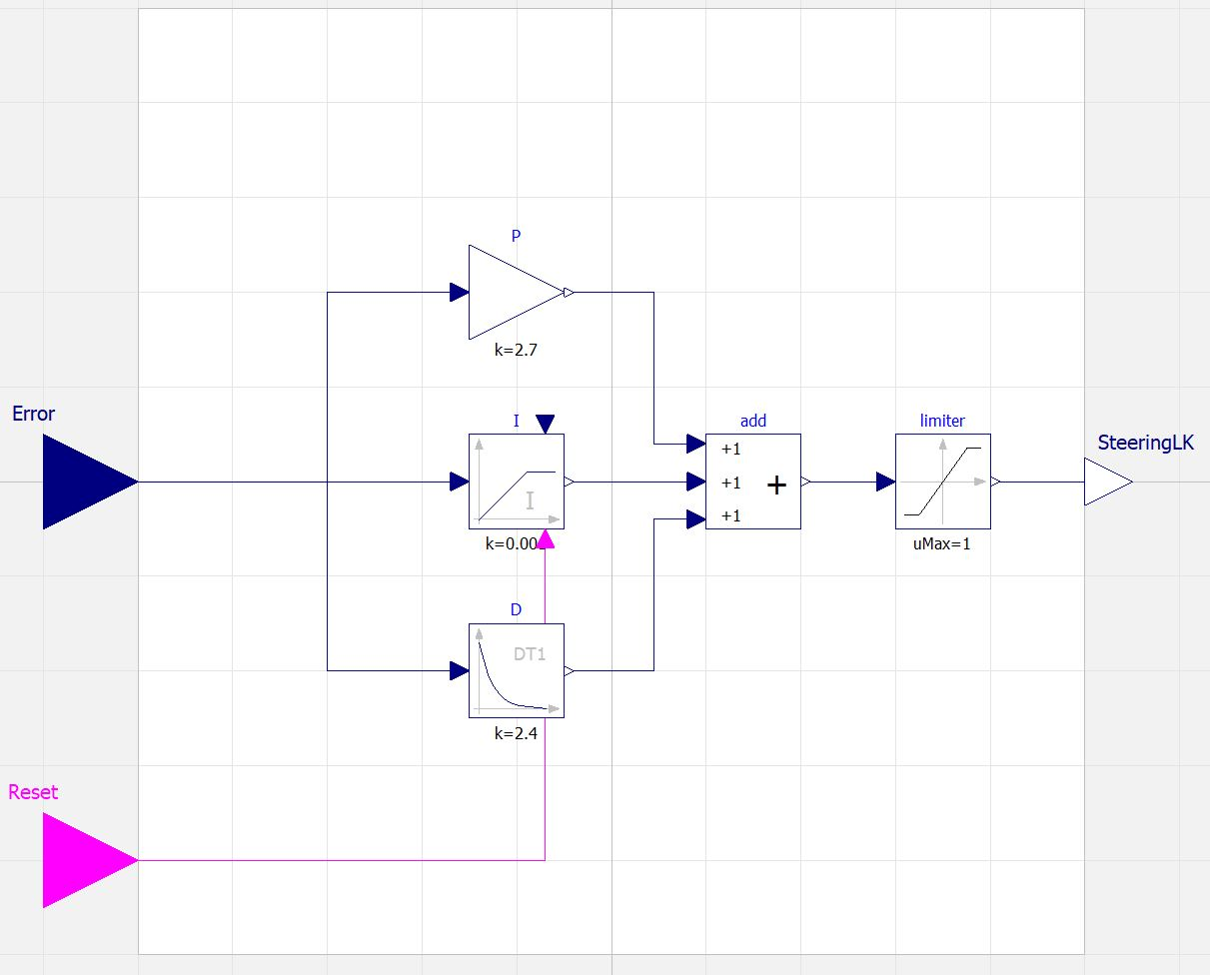
Case Study
FF1 Rover
Cyber-physical system
MbSE demonstrator of fortiss
Collaborative FF1
11 consistency rules defined in OCL format
About matching parameters, planned/needed quantities, names, interfaces, etc.
Confidential data: network protocols, internal costs, certain computation parameters, algorithms, detailed material composition, physical connection designs

Slide 9
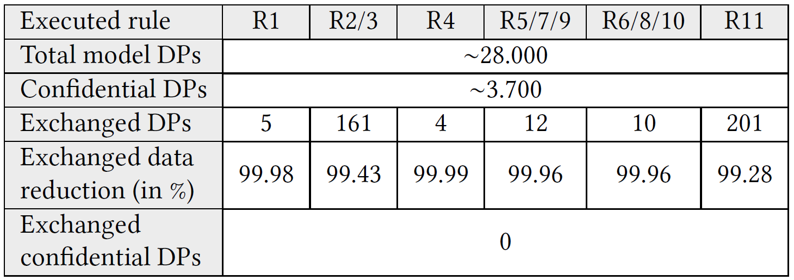
Case Study
Collaborative FF1
Test setup:
Each tool operated by a different party
Forced inconsistencies targeting none, one, or multiple rules in parallel (183 test runs in total)
Results:
E.g., reduced exchanged data with AF3 adapter: (DP = data point)
Correctness: C⁴ detected every forced inconsistency
Confidentiality: C⁴ did not forward any confidential data to unauthorized parties
Extensibility: three modeling tools with different metamodels and languages

Slide 10


Conclusion
Sebastian Bergemann
bergemann@fortiss.org
Approach for checking consistency between multiple potential heterogeneous models in a collaborative environment without the need of directly exchanging model data between the involved collaborators to reduce the risk of leaking confidential information
Benefits (tested on C⁴ prototype):
No direct data exchange between involved parties
Models are kept under owner’s control
Reduce check failures by only requesting the minimal necessary data
Easily extensible
Good base for further experiments
Any questions or feedback?
Partly funded by the German Federal Ministry of Education and Research (BMBF)
Project: BaSys4Transfer
Grant no.: 01IS22089F

Slide 11
Contact
Sebastian Bergemann
bergemann@fortiss.org
fortiss GmbH Guerickestr. 25 80805 Munich

